Slide 1
AI-510: Duke Resources Hub
- Group 6
Jingwei Li
Thomas McGuire
Samyukta Palle

Slide 2

Business Understanding
Let’s meet Sally!
She is a new DUKE student who is focused on environment issues like divestment from fossil fuels and environmental justice.
Data Understanding
Data Preparation
Modelling
Evaluation
Deployment

Slide 3



Business Understanding
RESOURCES
1. Websites:
https://sites.duke.edu/prattgsps/
https://gpsg.duke.edu/
https://dukegroups.com/
Data Understanding
Data Preparation
Modelling
Evaluation
2. Orientation
Deployment

Slide 4
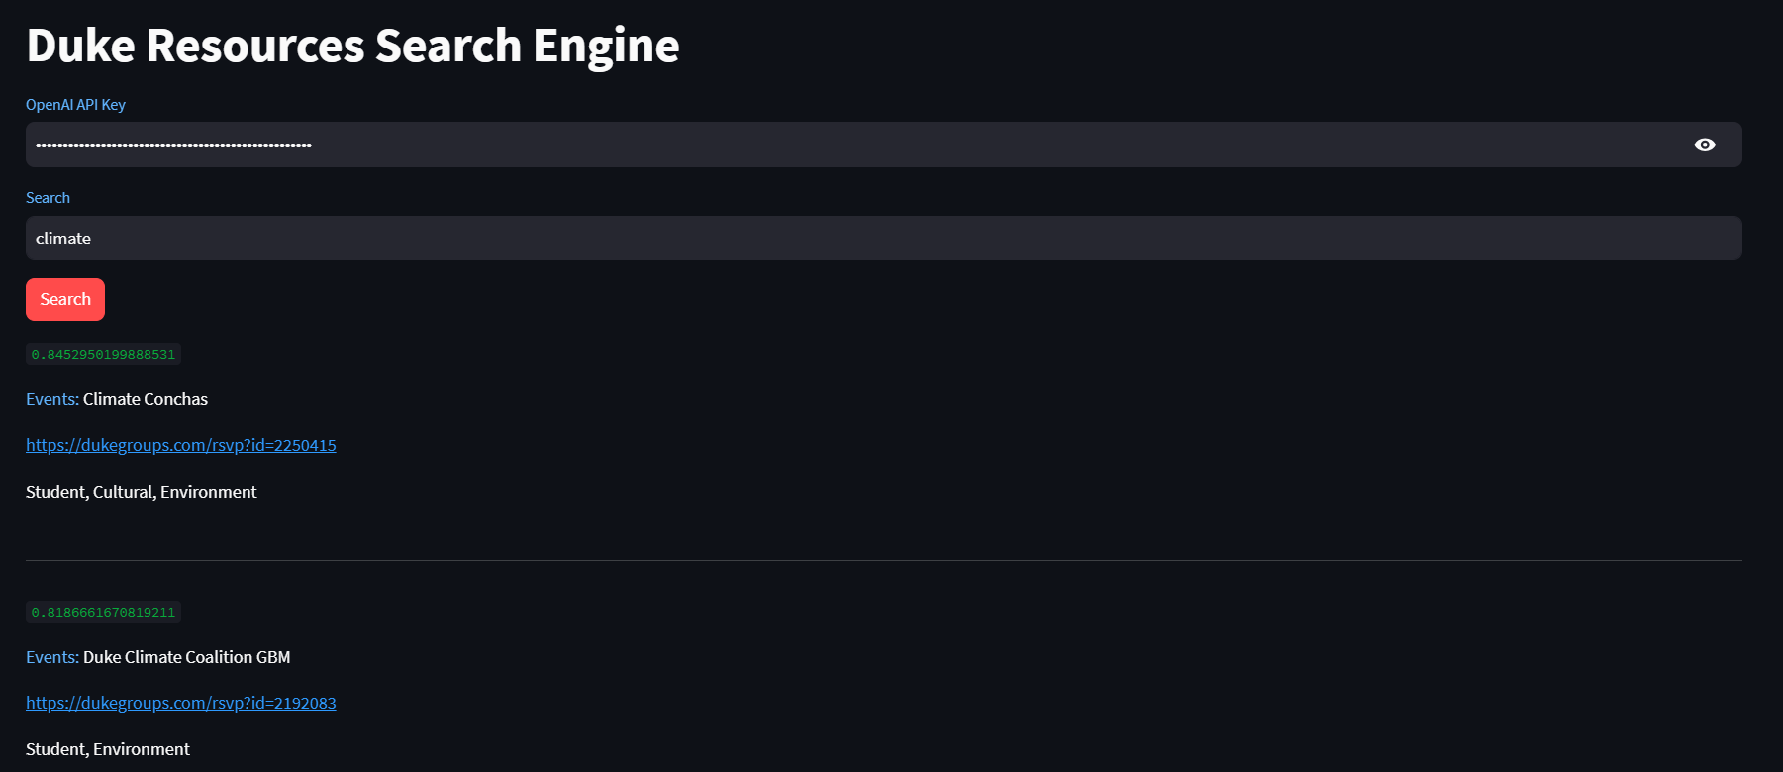
Business Understanding
SOLUTION
Data Understanding
Data Preparation
Modelling
Evaluation
Duke Resource Hub:
Centralized platform for all Duke resources.
Personalized filtering based on user preferences.
Deployment

Slide 5


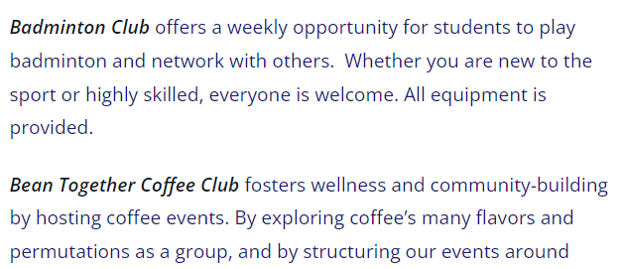

Business Understanding
GATHER DATA
1. Scraped data from various sources, including:
https://sites.duke.edu/prattgsps/
https://gpsg.duke.edu/
https://dukegroups.com/
2. Created a phonebook csv file.
Data Understanding
Events: Title, Link, Group
Data Preparation
Modelling
Groups: Title, Link, Mission
GSPS & GPSG: Name, Description
Evaluation
Selected features:
Name
Type
Description
Reference link.
Deployment
Sqlite3 Database

Slide 6
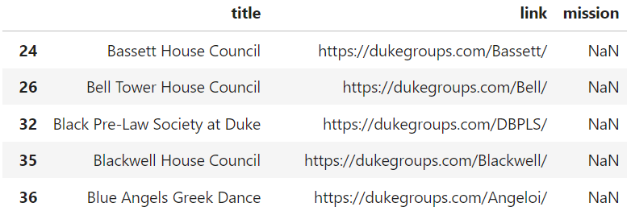
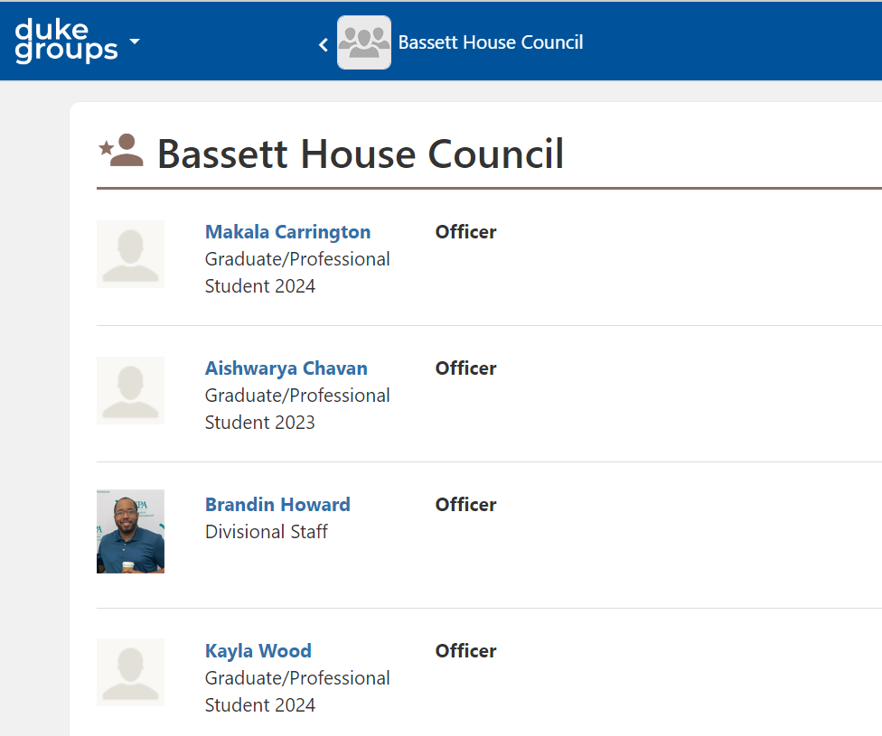
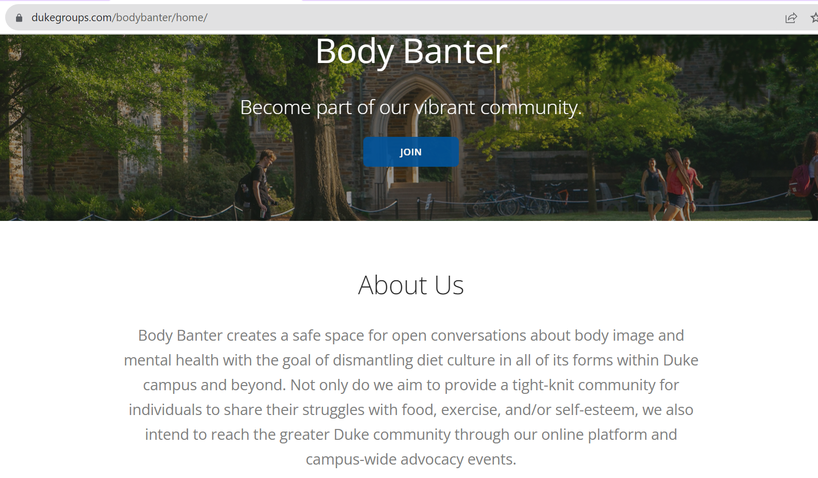
Business Understanding
VALIDATE DATA
Data Understanding
Data Preparation
Additional web scraping
Modelling
Evaluation
Deployment
Manual data collection.

Slide 7
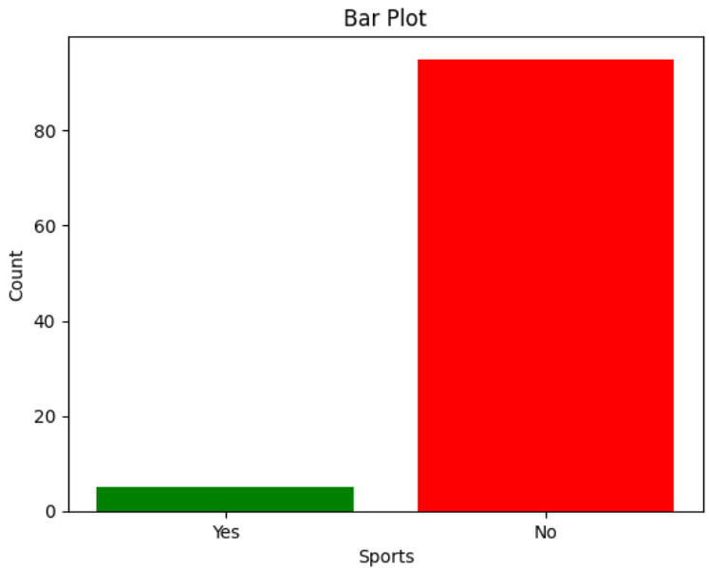
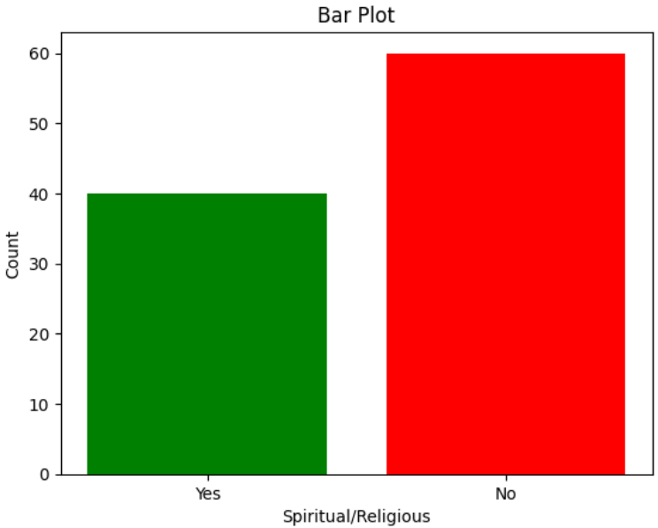
Business Understanding
DATA LABELS
Data Understanding
Data Preparation
DATA TRANSFORMATIONS
Modelling
Stop words
TfID Vectorizer
Logistic Regression
Evaluation
Challenge: Creating Labels for each Tag
Deployment

Slide 8


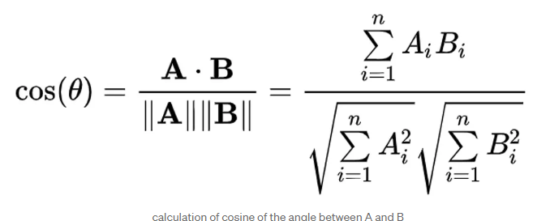

Business Understanding
MODELLING
Classification attempt with tags.
Txtai for embeddings.
OpenAI API for embeddings (ada-embedding).
Data Understanding
Data Preparation
EVALUATION
Used cosine similarity between the search keyword(A) & the Description of resources (B)
Modelling
DEPLOYMENT
Evaluation
Developed a Streamlit application serving as a search engine.
Deployment

Slide 9
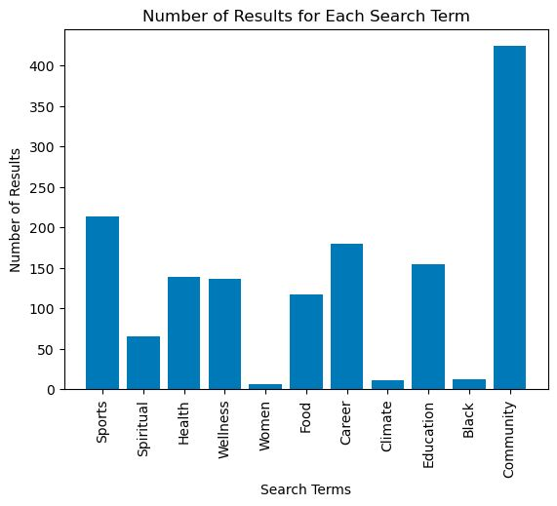
LEARNINGS
Distribution of each key word.
Various ways to collect & create data
Different forms of Embeddings

Slide 10
Thank you

